Slide 1
Haiti‘s Profound Sorrow
Pulitzer Prize 2011
Breaking News
The Washington Post

Slide 2
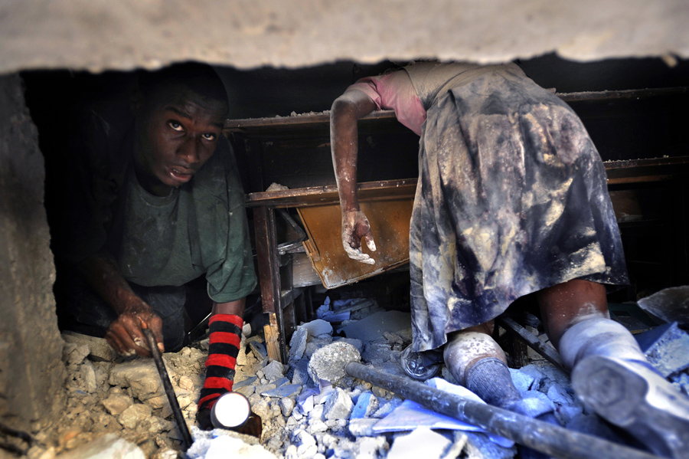

Slide 3


Slide 4


Slide 5
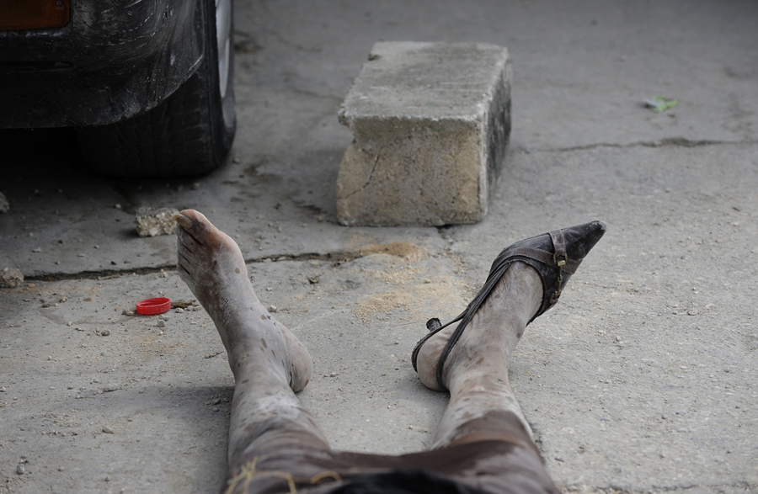

Slide 6
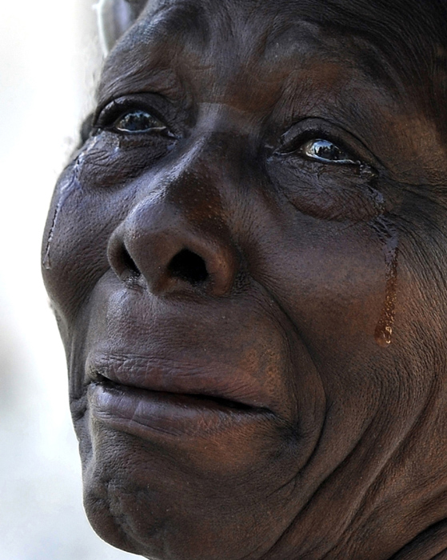

Slide 7


Slide 8


Slide 9
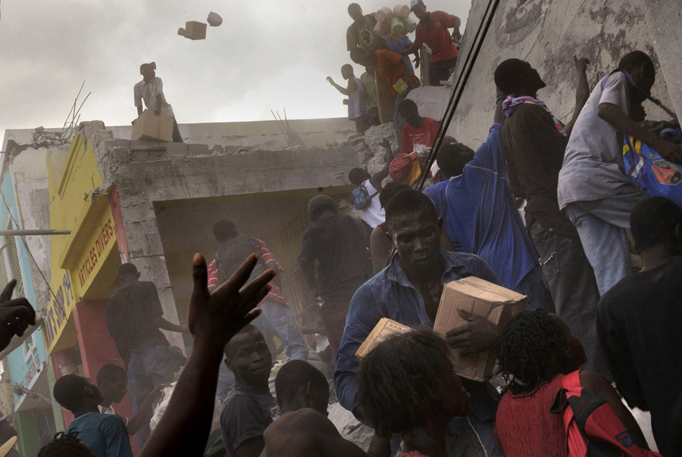

Slide 10


Slide 11
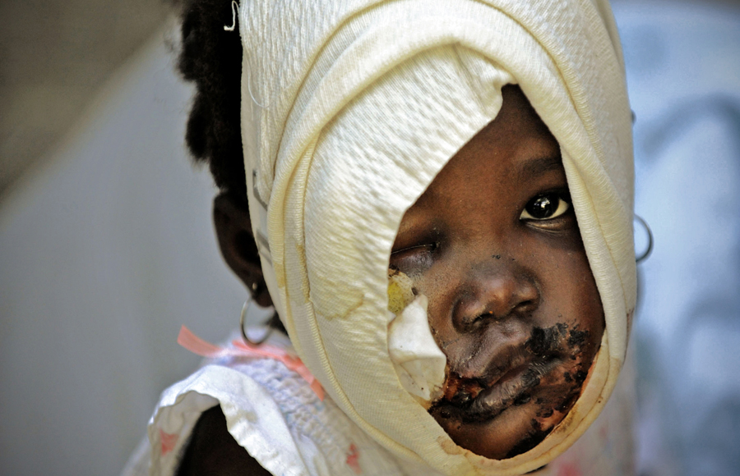

Slide 12
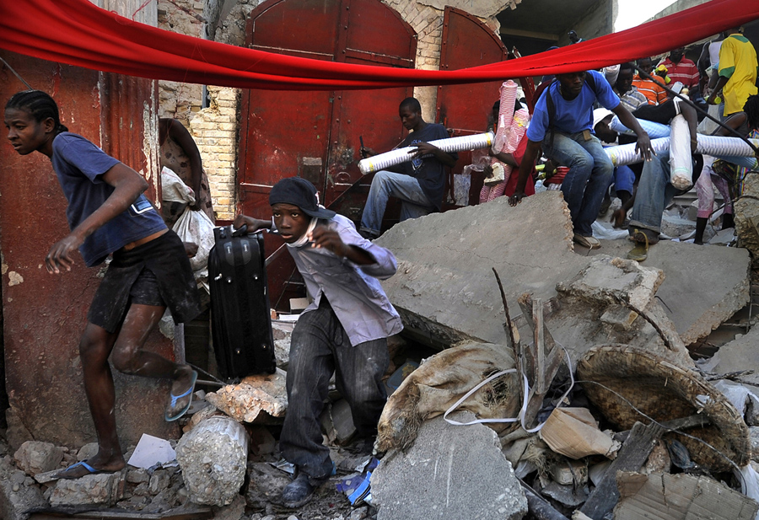

Slide 13


Slide 14


Slide 15
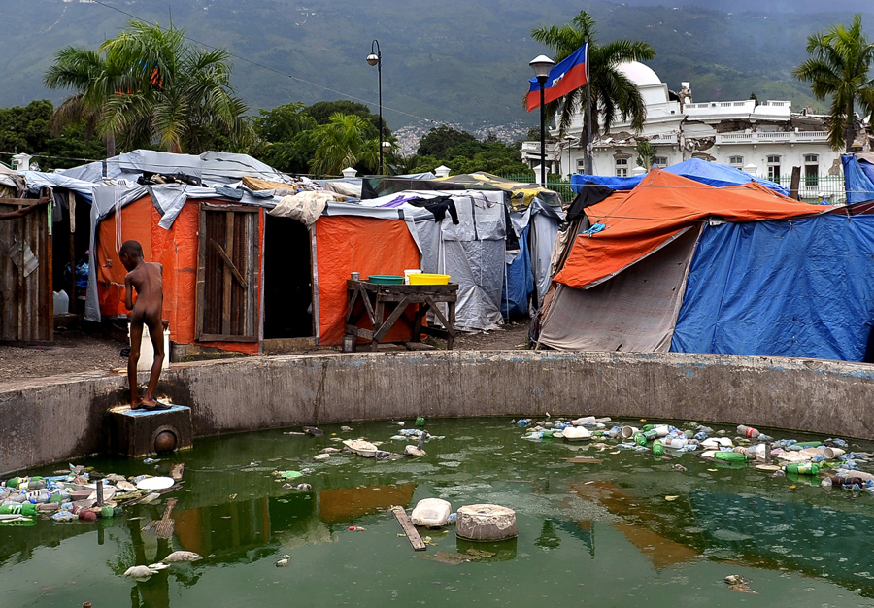

Slide 16
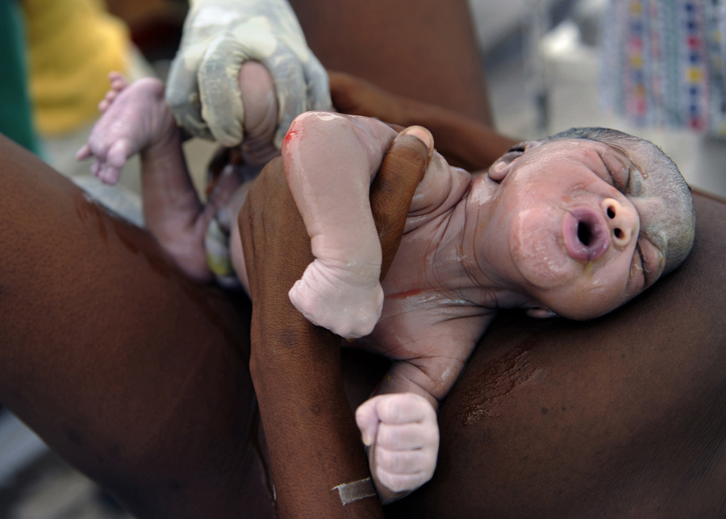

Slide 17
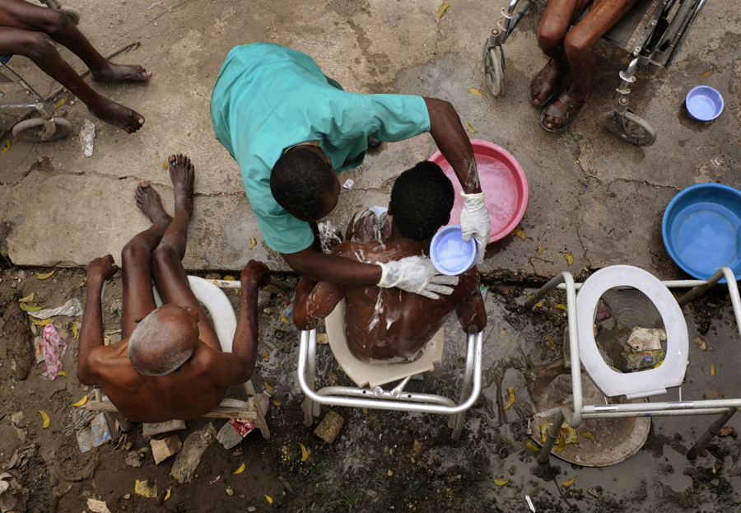

Slide 18
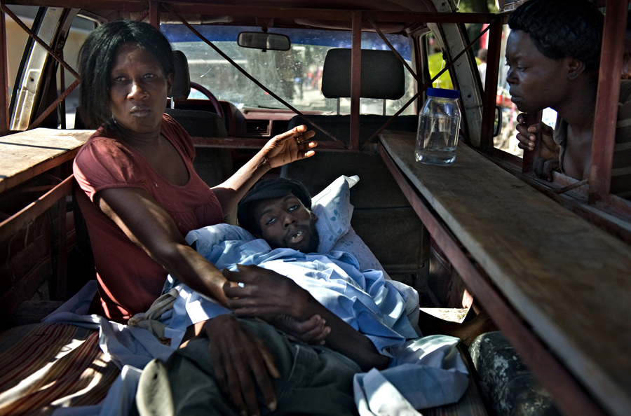

Slide 19


Slide 20
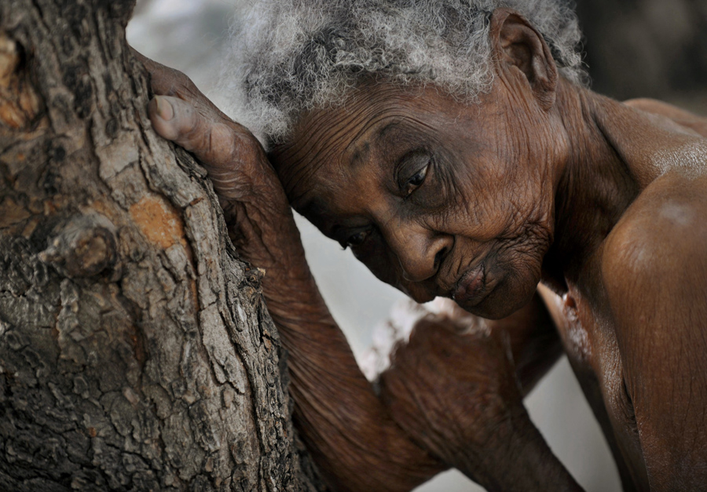

Slide 21


